Slide 1
Creating Tables & Loading Data
Course 4- Week 2- RDBMS

Slide 2
Types of SQL Statements : DDL Vs. DML
DDL: Data Definition Language Statement:
Define, Change or Drop Data
Common DDL:
CREATE: used for creating tables and defining its columns
ALTER: is used for altering tables including adding and dropping columns and modifying their datatypes
TURNCATE: is used for deleting data in a table but not the table itself;
DROP: is used for deleting tables.
Data Manipulation language (DML):
Read and Modify data using CRUD (CREATE, READ, UPDATE, DELETE - ROWS) operations
Common DML:
INSERT: is used for inserting a row or several rows of data into a table;
SELECT: reads or selects row or rows from a table;
UPDATE: edits row or rows in a table;
DELETE: removes a row or rows of data from a table.

Slide 3
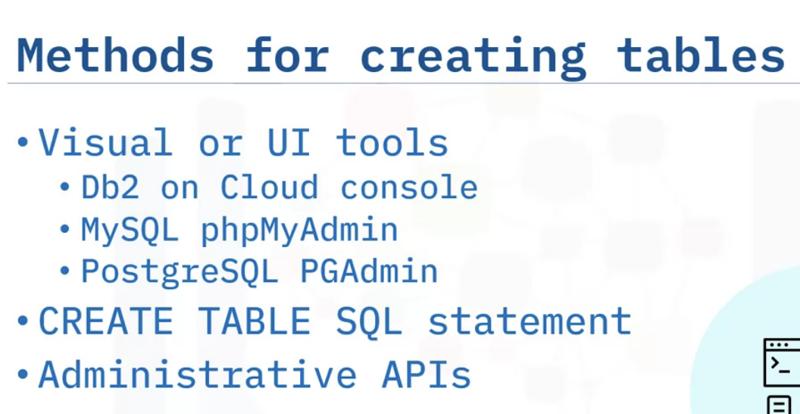
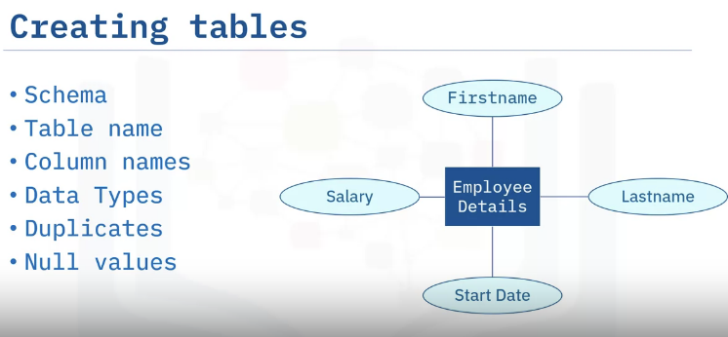
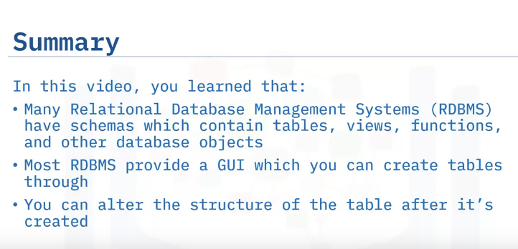
Creating Tables
Considerations for creating tables
How to create a table in a graphical interface like DB2 on cloud
How to alter table structure after creation

Slide 4
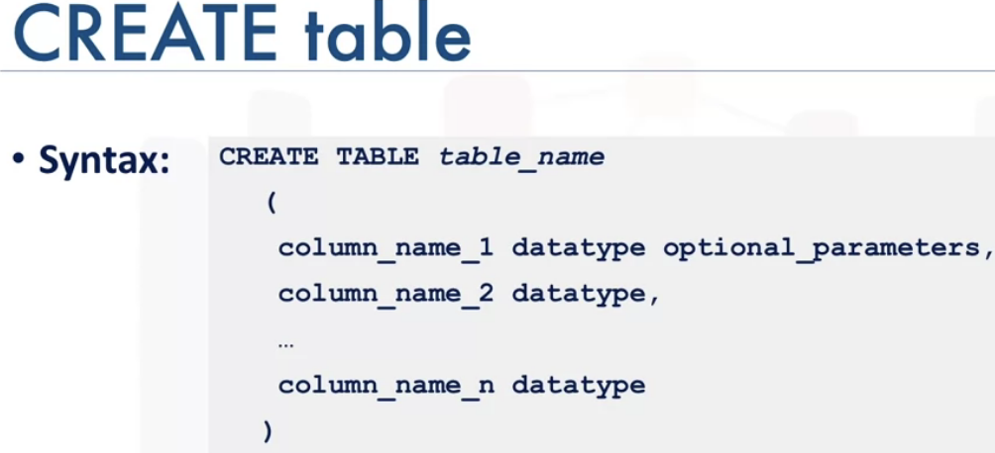
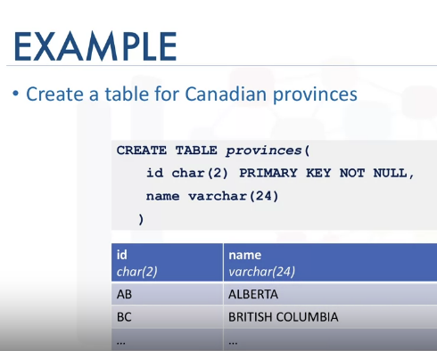
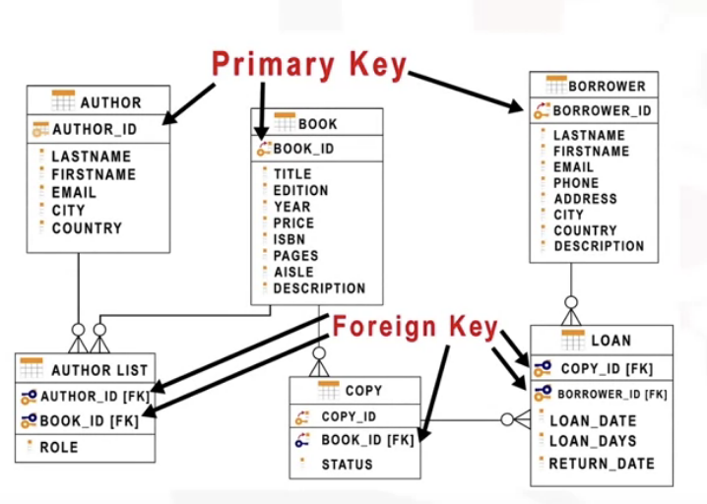
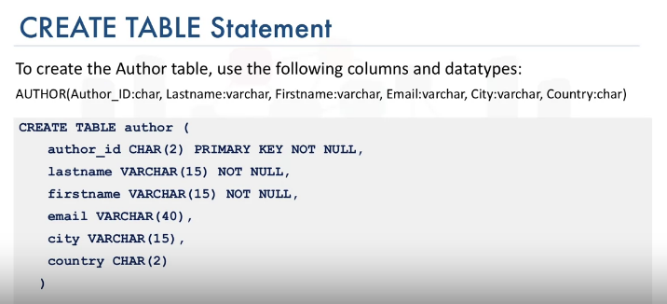
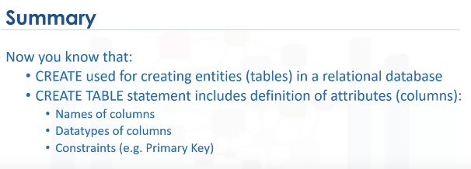

Slide 5
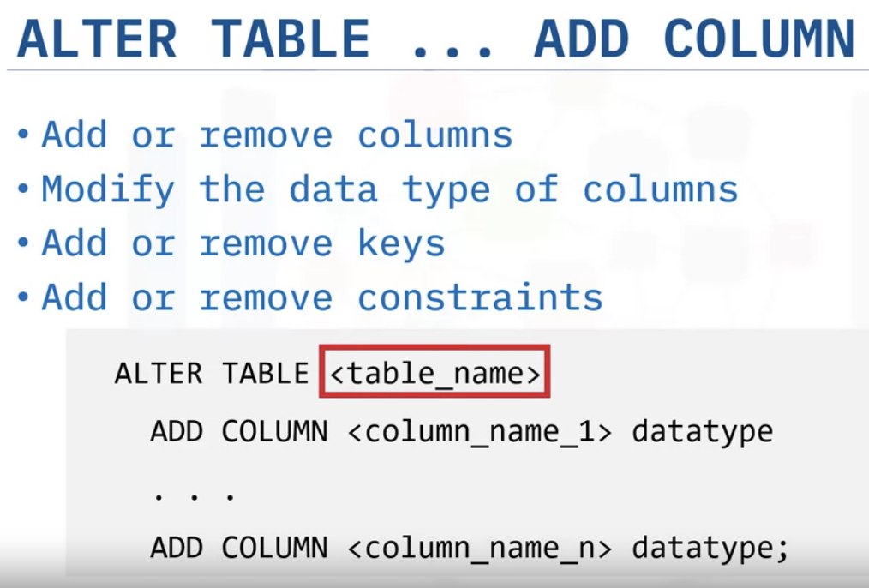
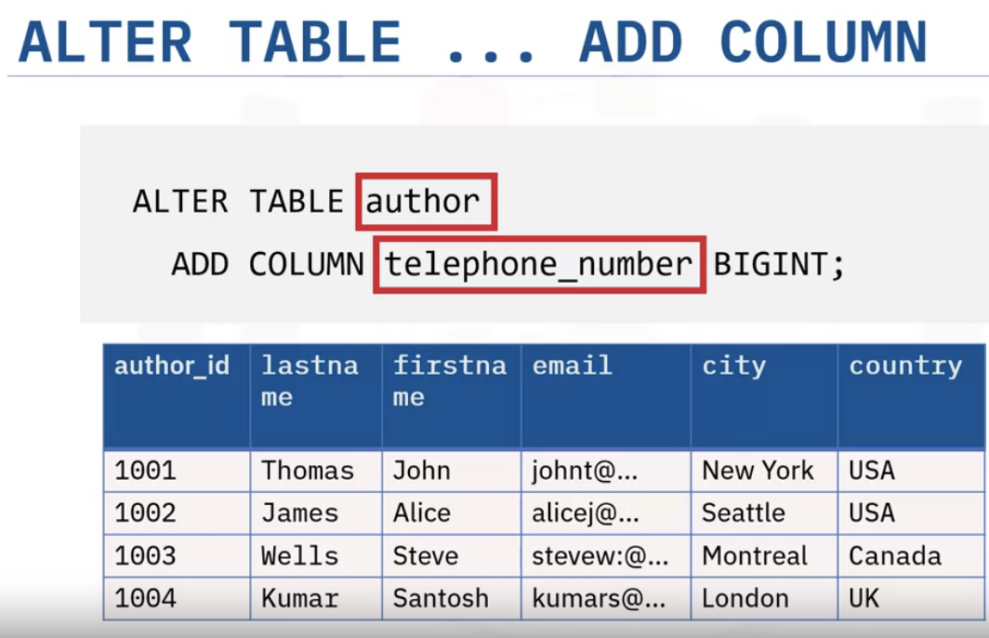
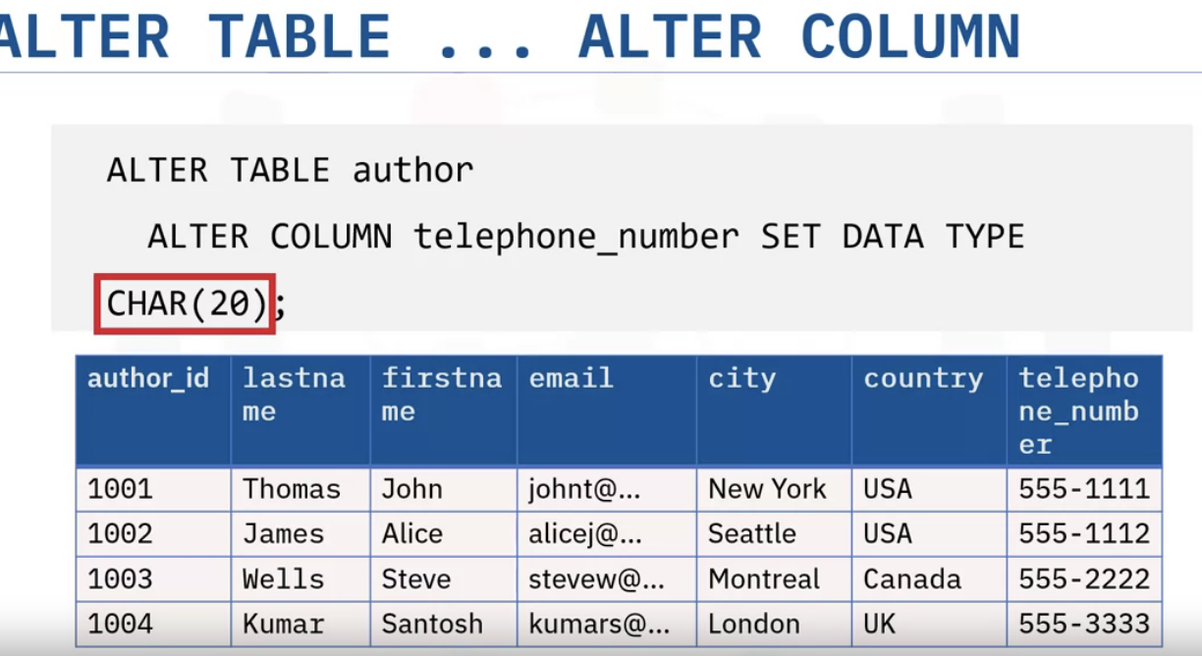

Slide 6
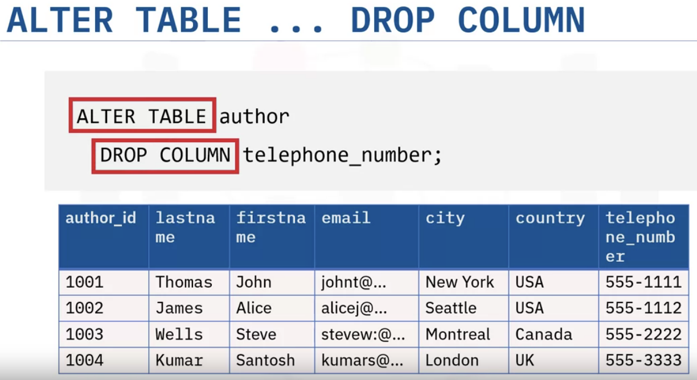
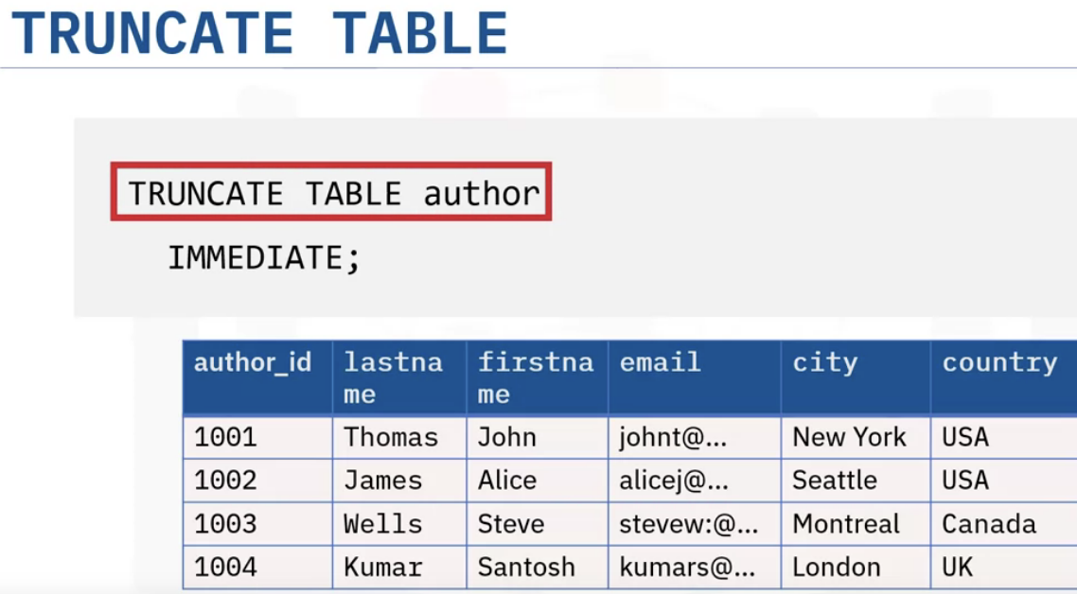
Table will remain as it is, but all the rows will be deleted.
Changes- column will be dropped.

Slide 7
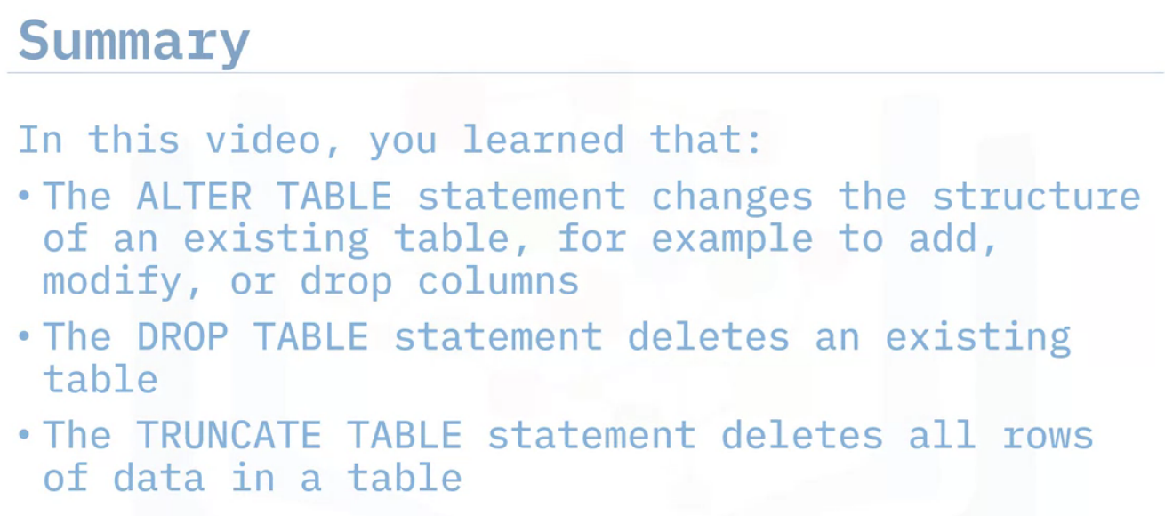

Slide 8
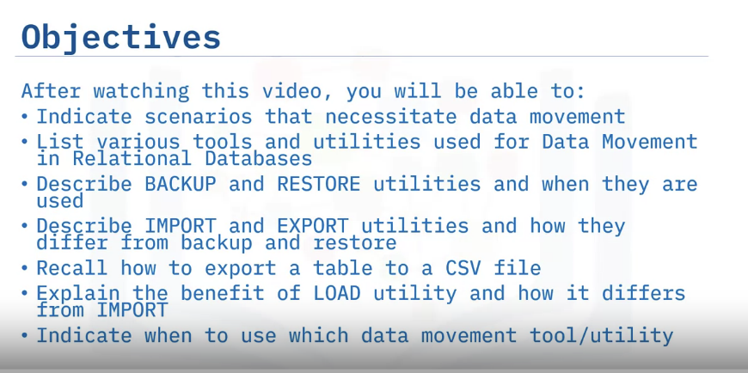
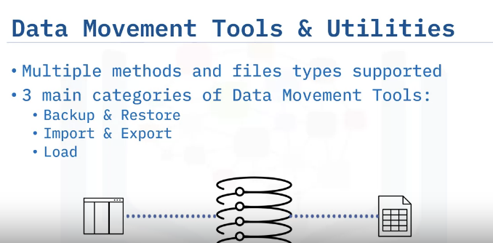
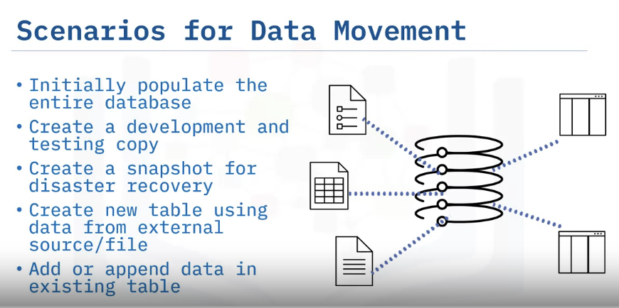
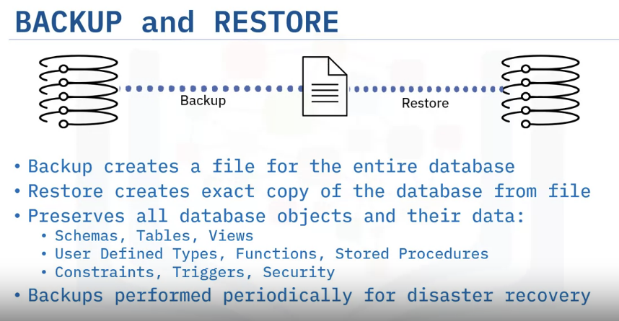
Data Movement Utilities

Slide 9
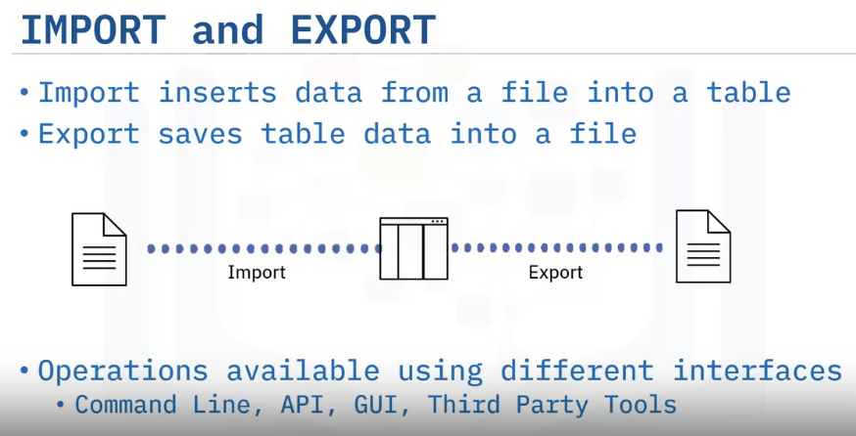
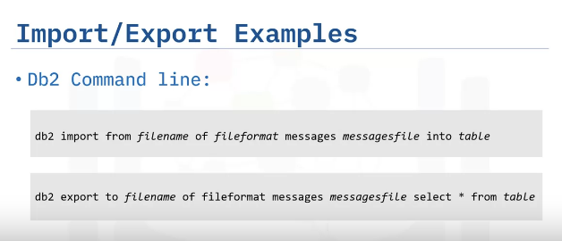
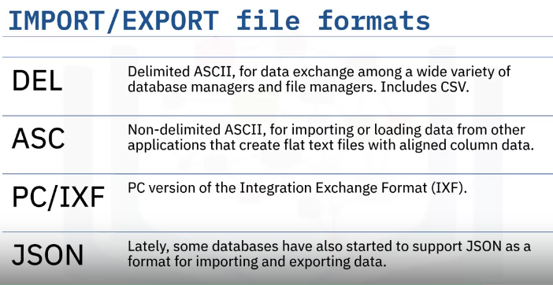
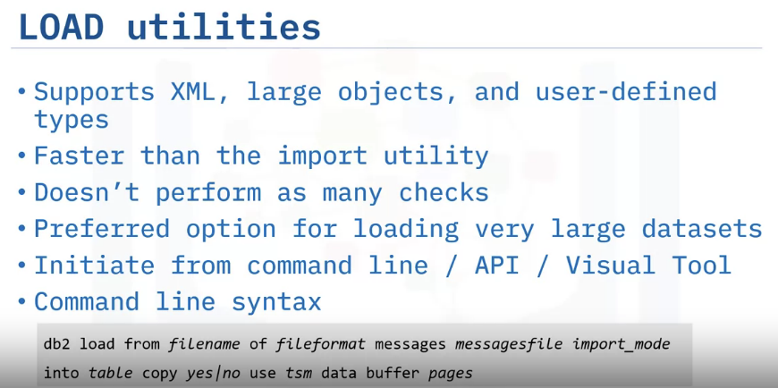

Slide 10
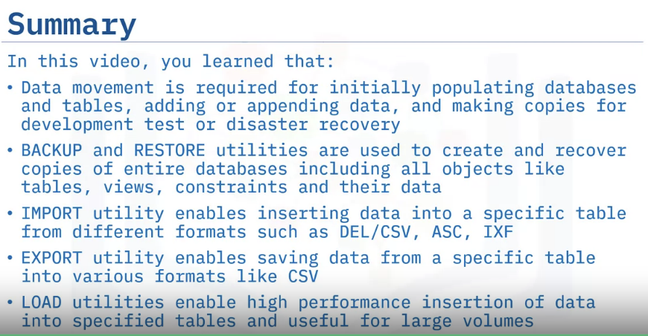

Slide 11
Loading Data
Explain when to use ‘Load Data’ functionality
List types of Data Source you can Load Data from
Describe Load Data Process

Slide 12
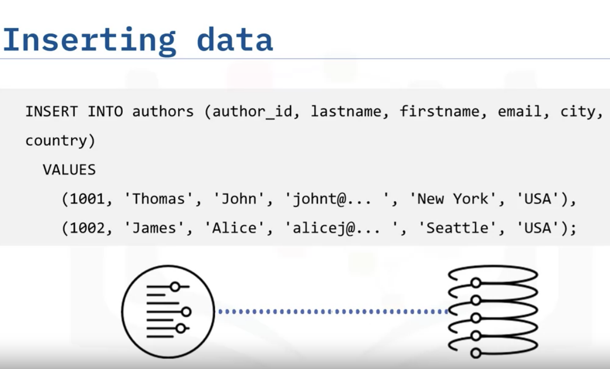
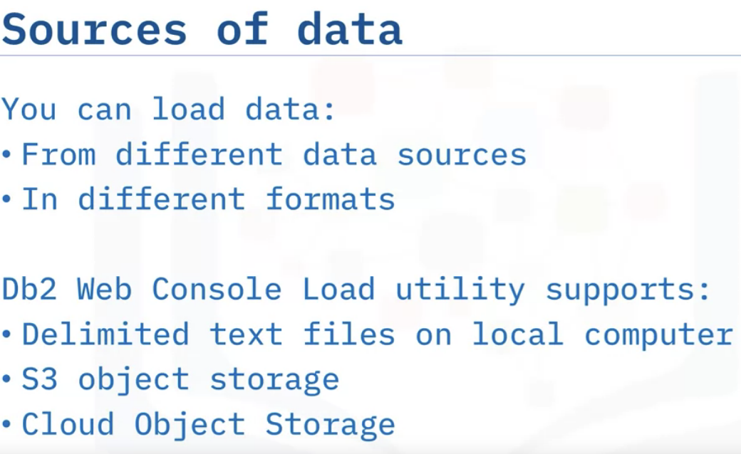
Inserting method is not suitable when there are large amount of data to be inserted. Instead, RDBMS provides an efficient and scalable way.

Slide 13
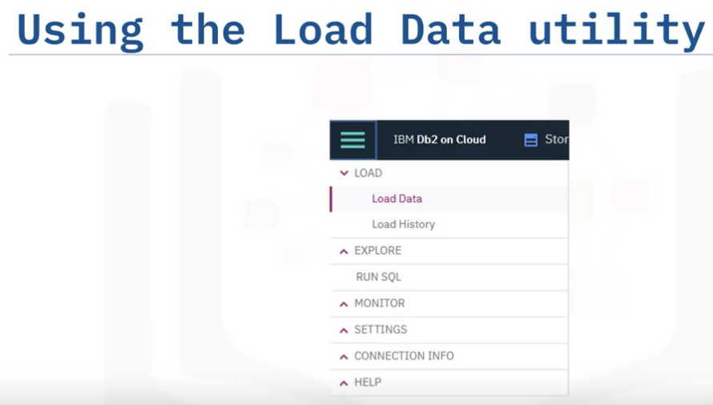
4 Steps to loading the data:
Source
Target
Define
Finalize

Slide 14
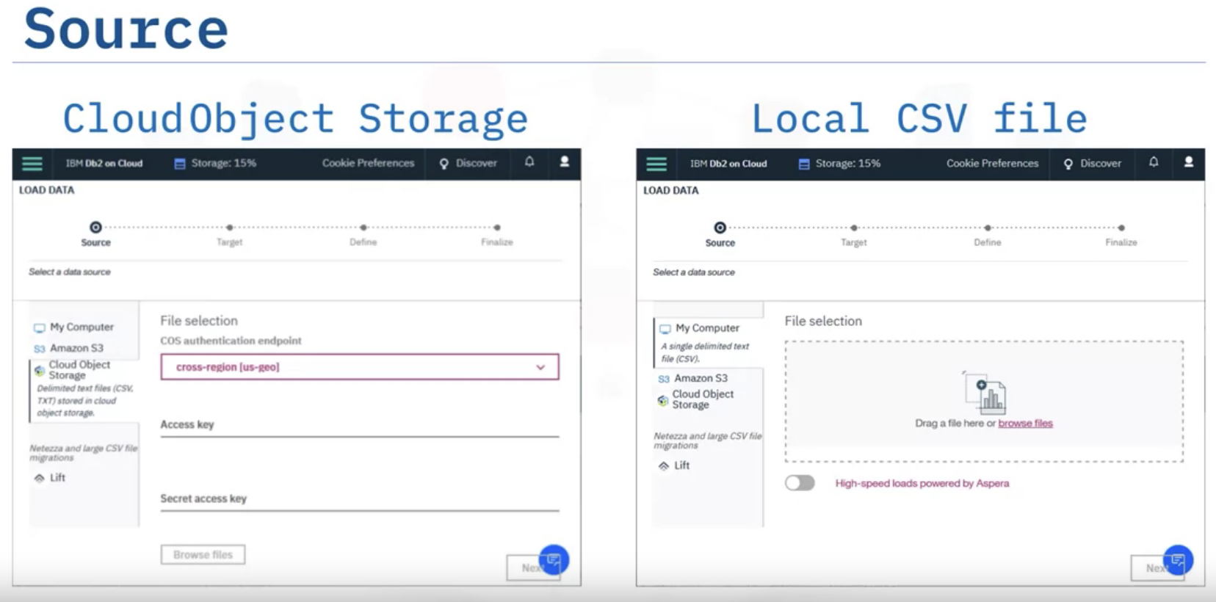

Slide 15
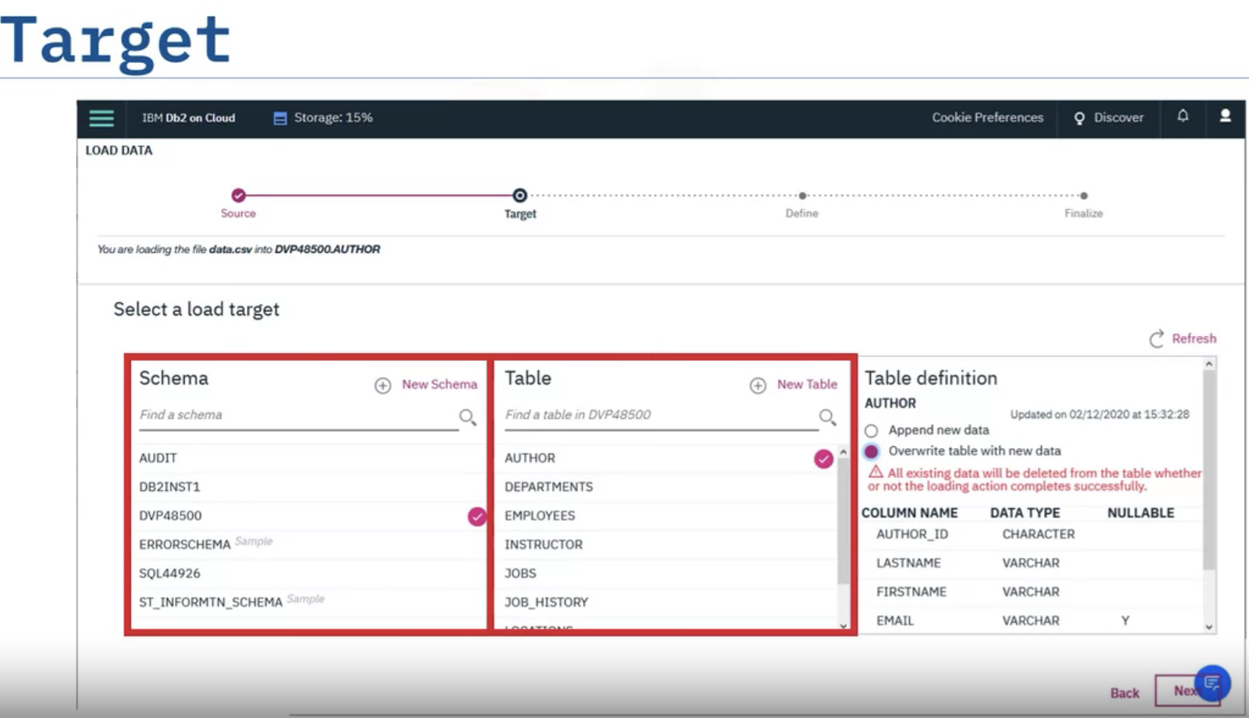

Slide 16
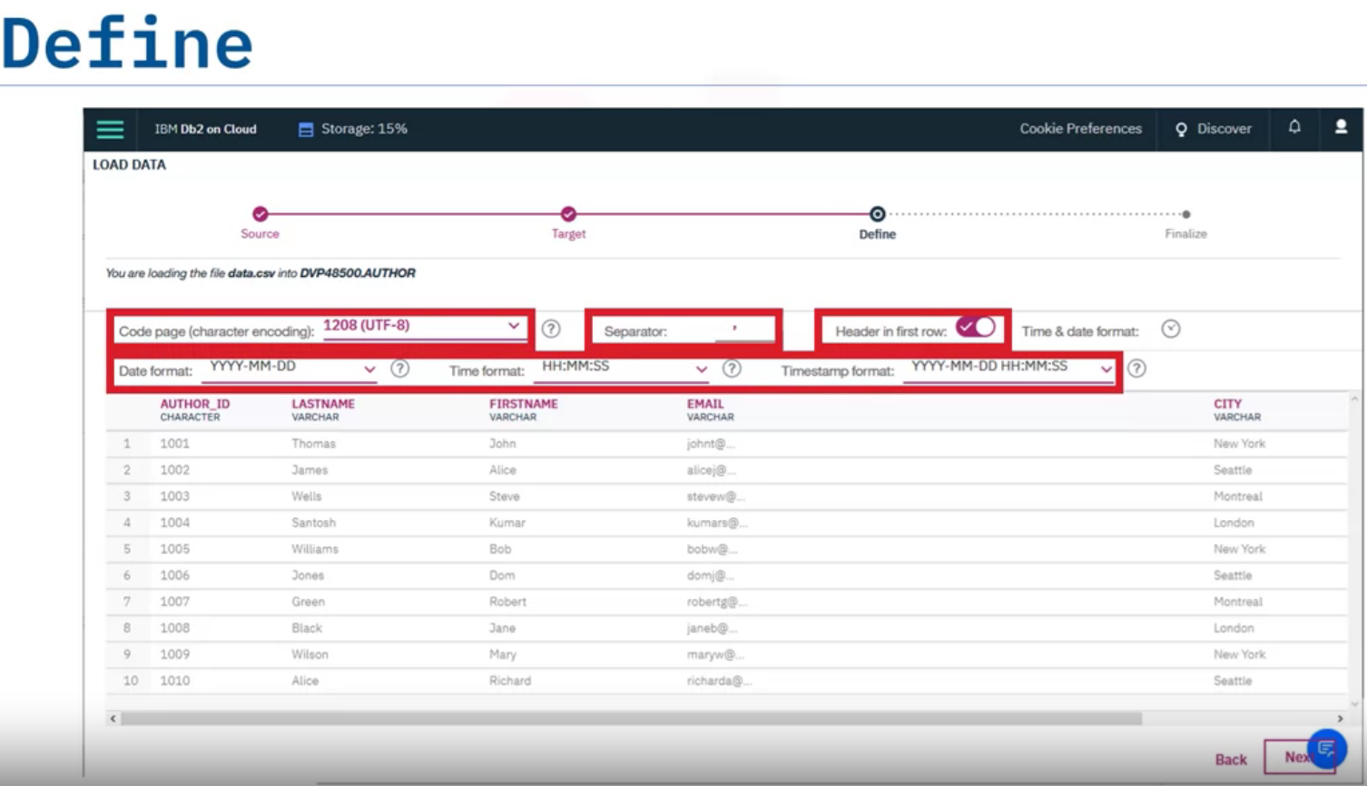

Slide 17
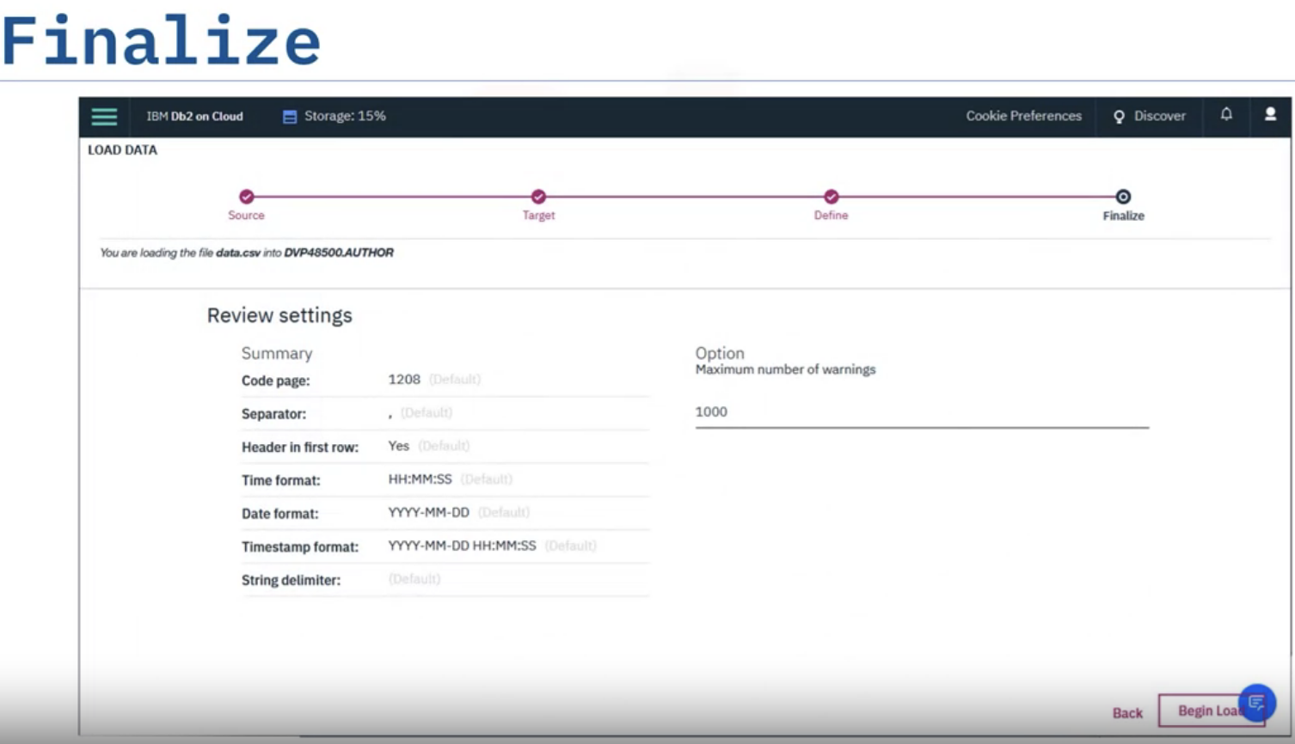

Slide 18
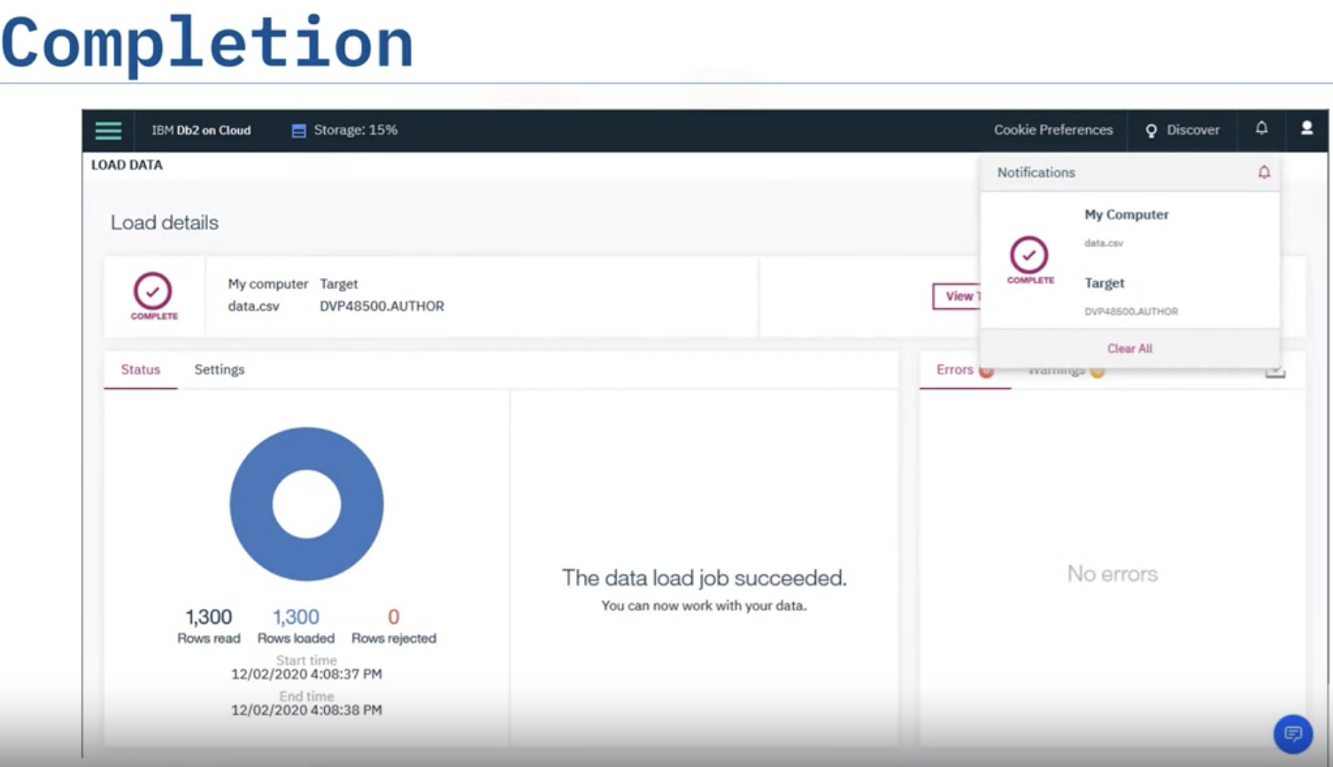

Slide 19
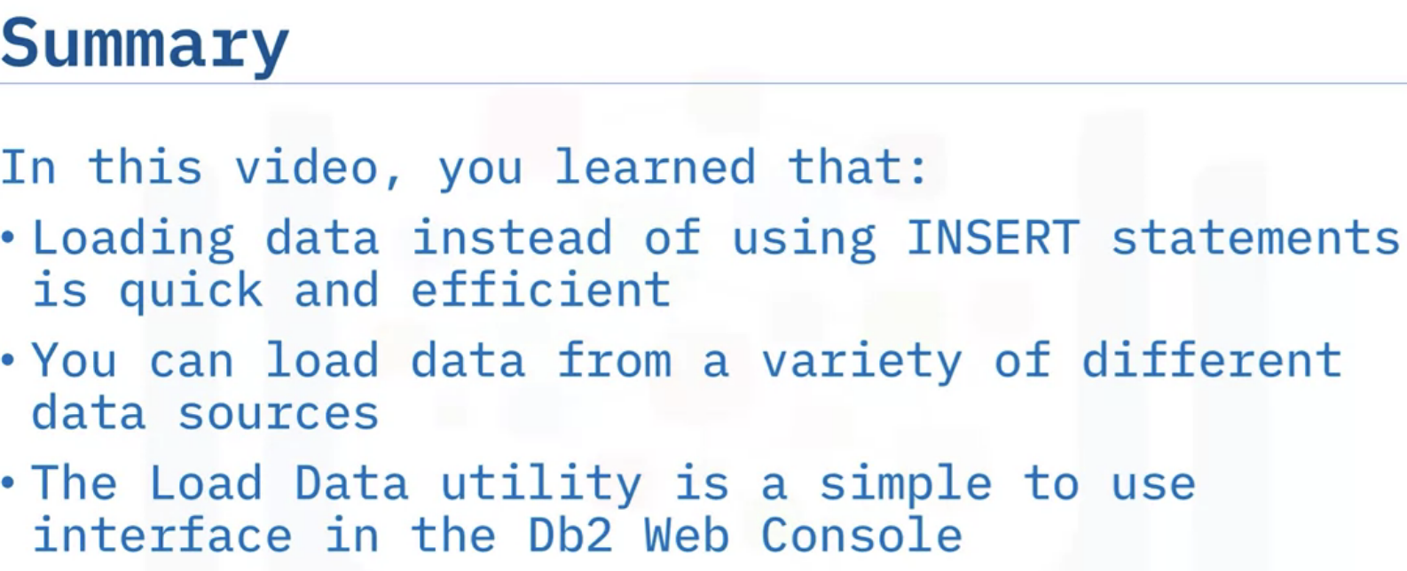
Loading Data

Slide 20
Summary & Highlights
At this point in the course, you know:
DDL statements, including CREATE, ALTER, TRUNCATE, and DROP, are used for defining objects like tables in a database.
DML statements, including INSERT, SELECT, UPDATE, and DELETE, are used for manipulating data in tables.
Many Relational Database Management Systems (RDBMS) have schemas that contain tables, views, functions, and other database objects.
Most RDBMS provide a GUI through which you can create and alter the structure of tables.
You can also create and alter tables by using DDL SQL statements:
CREATE TABLE. Creates entities (tables) in a relational database and sets the attributes (columns) in a table, including the names of columns, the data types of columns, and constraints (for example, the Primary Key.)
ALTER TABLE. Changes the structure of a table by adding or removing columns, modifying the data type of columns, and adding or removing keys and constraints.
DROP TABLE. Deletes a table from a database.
TRUNCATE TABLE. Removes all rows in a table.
There are utilities that help you to manage the movement of data:
You use the BACKUP and RESTORE utilities to create and recover copies of entire databases, including all objects like tables, views, constraints, and data.
You use the IMPORT utility to insert data into a specific table from different formats, such as DEL/CSV, ASC and IXF, and the EXPORT utility to save data from a specific table into various formats, such as CSV.
You can use the LOAD utilities, instead of INSERT statements, to quickly insert large amounts of data a variety of different data sources into tables.
The Load Data utility is a simple to use interface in the Db2 Web Console.

